Slide 1
Topics of this course
What is CS
Why is CS so hot
Where is CS being applied to
Lect 9: How to learn CS

Slide 2

General tip 1
Seeking and staying true to your interest

Slide 3

No silver bullet! No free lunch.
General tip 2

Slide 4


General tip 3

Slide 5
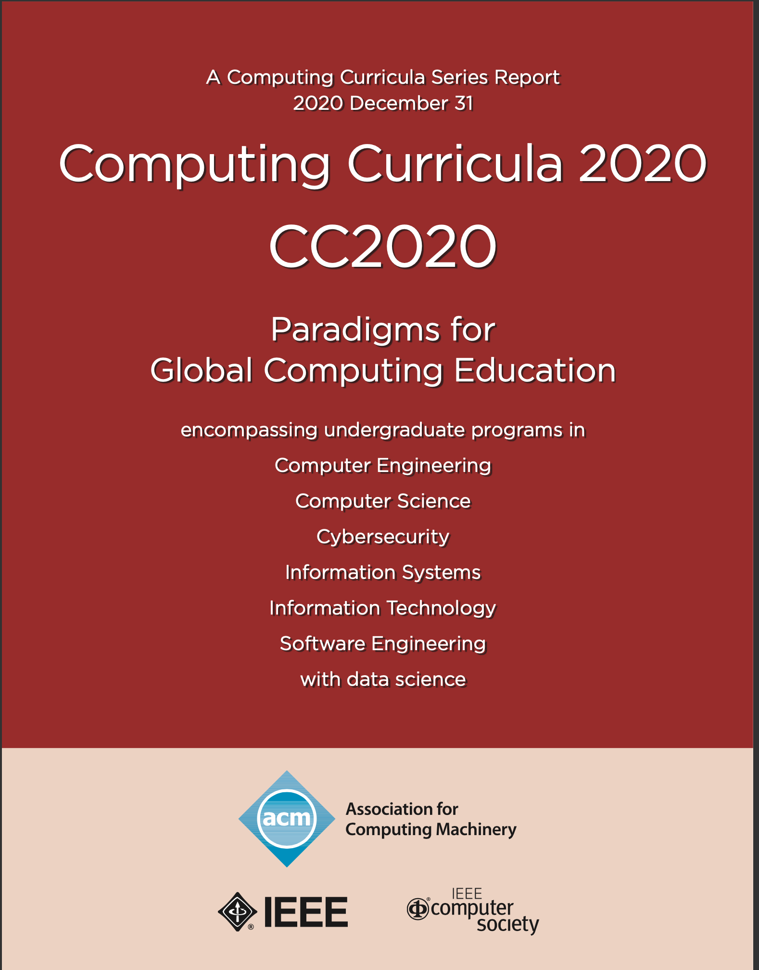

Slide 6
Contents of CS: disciplines evolvement (CC2020)
Computing Science:
Computer engineering (from EE)
Computer science (into a mature academic discipline)
Cybersecurity
Information systems (computers into organization/working environment)
Information technology (infrastructure)
Software engineering (emerging as a discipline based on CS/CE)
Data science
AI
Notes:
As originally expressed in CC2005 [Acm02], computing includes a variety of interpretations such as designing and constructing hardware and software systems for a wide range of purposes: processing, structuring, and managing various kinds of information; problem solving by finding solutions to problems or by proving a solution does not exist; making computer systems behave intelligently; creating and using communications and entertainment media; and finding and gathering information relevant to any particular purpose.

Slide 7
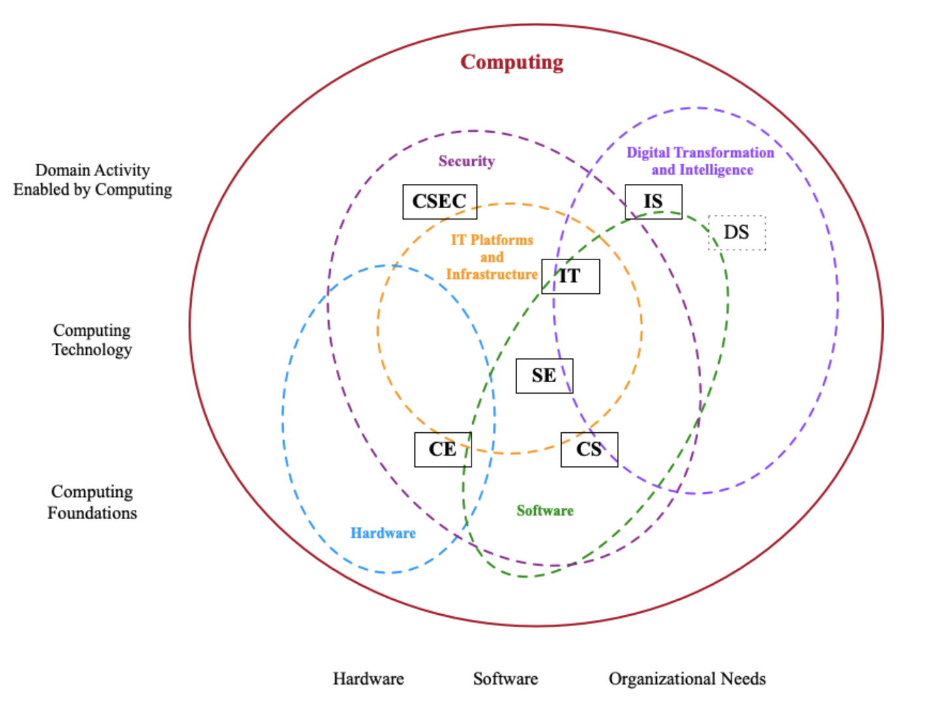
What is CS: discipline evolvement (CC2020)
Computing Science:
Computer engineering (from EE)
Computer science (into mature academic dicipline)
Cybersecurity
Information systems (computers into organization/working envir.)
Information technology (infrastructure)
Software engineering (emerging as a discipline based on CS/CE)
Data science
AI
Notes:
As originally expressed in CC2005 [Acm02], computing includes a variety of interpretations such as designing and constructing hardware and software systems for a wide range of purposes: processing, structuring, and managing various kinds of information; problem solving by finding solutions to problems or by proving a solution does not exist; making computer systems behave intelligently; creating and using communications and entertainment media; and finding and gathering information relevant to any particular purpose.

Slide 8
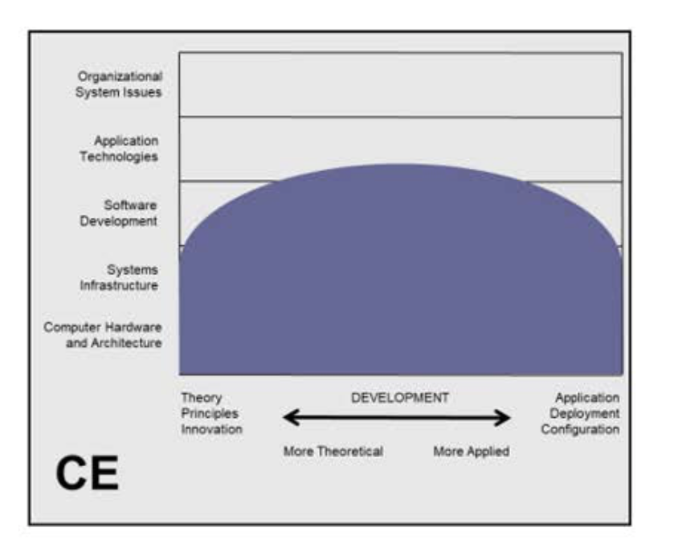
What is CS: discipline evolvement (CC2020)
Computing Science:
Computer engineering (from EE)
Computer science (into mature academic dicipline)
Cybersecurity
Information systems (computers into organization/working envir.)
Information technology (infrastructure)
Software engineering (emerging as a discipline based on CS/CE)
Data science
AI
Notes:
As originally expressed in CC2005 [Acm02], computing includes a variety of interpretations such as designing and constructing hardware and software systems for a wide range of purposes: processing, structuring, and managing various kinds of information; problem solving by finding solutions to problems or by proving a solution does not exist; making computer systems behave intelligently; creating and using communications and entertainment media; and finding and gathering information relevant to any particular purpose.

Slide 9
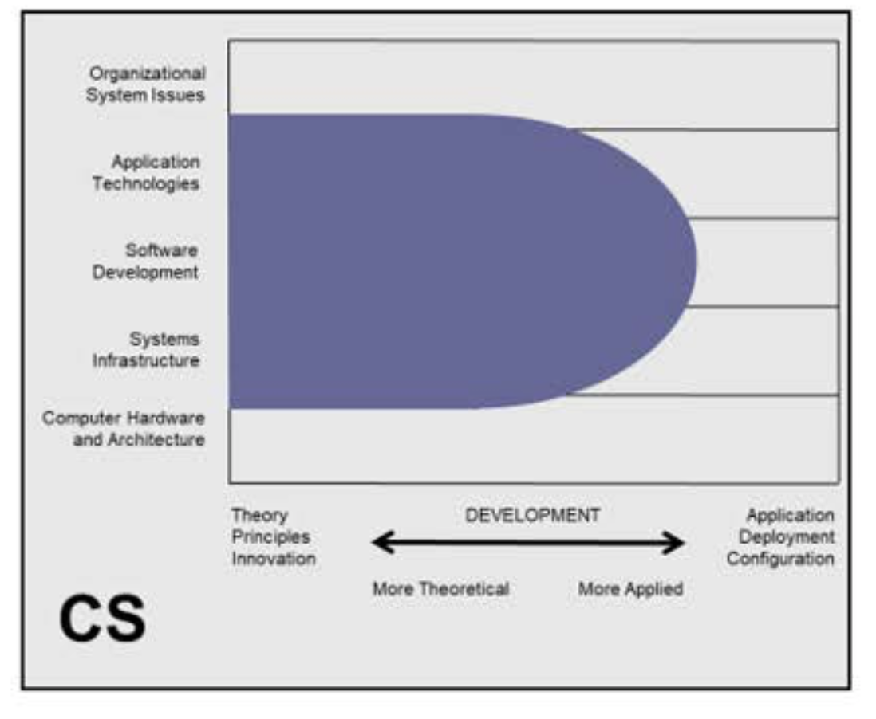
What is CS: discipline evolvement (CC2020)
Computing Science:
Computer engineering (from EE)
Computer science (into mature academic dicipline)
Cybersecurity
Information systems (computers into organization/working envir.)
Information technology (infrastructure)
Software engineering (emerging as a discipline based on CS/CE)
Data science
AI
Notes:
As originally expressed in CC2005 [Acm02], computing includes a variety of interpretations such as designing and constructing hardware and software systems for a wide range of purposes: processing, structuring, and managing various kinds of information; problem solving by finding solutions to problems or by proving a solution does not exist; making computer systems behave intelligently; creating and using communications and entertainment media; and finding and gathering information relevant to any particular purpose.

Slide 10
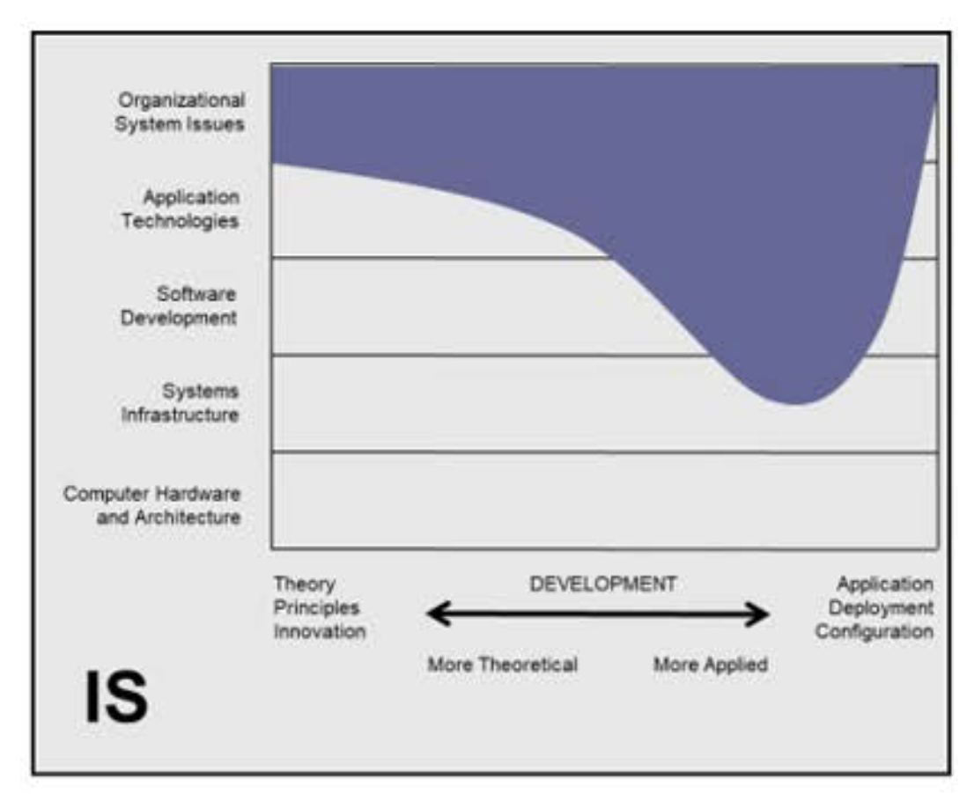
What is CS: discipline evolvement (CC2020)
Computing Science:
Computer engineering (from EE)
Computer science (into mature academic dicipline)
Cybersecurity
Information systems (computers into organization/working envir.)
Information technology (infrastructure)
Software engineering (emerging as a discipline based on CS/CE)
Data science
AI
Notes:
As originally expressed in CC2005 [Acm02], computing includes a variety of interpretations such as designing and constructing hardware and software systems for a wide range of purposes: processing, structuring, and managing various kinds of information; problem solving by finding solutions to problems or by proving a solution does not exist; making computer systems behave intelligently; creating and using communications and entertainment media; and finding and gathering information relevant to any particular purpose.

Slide 11
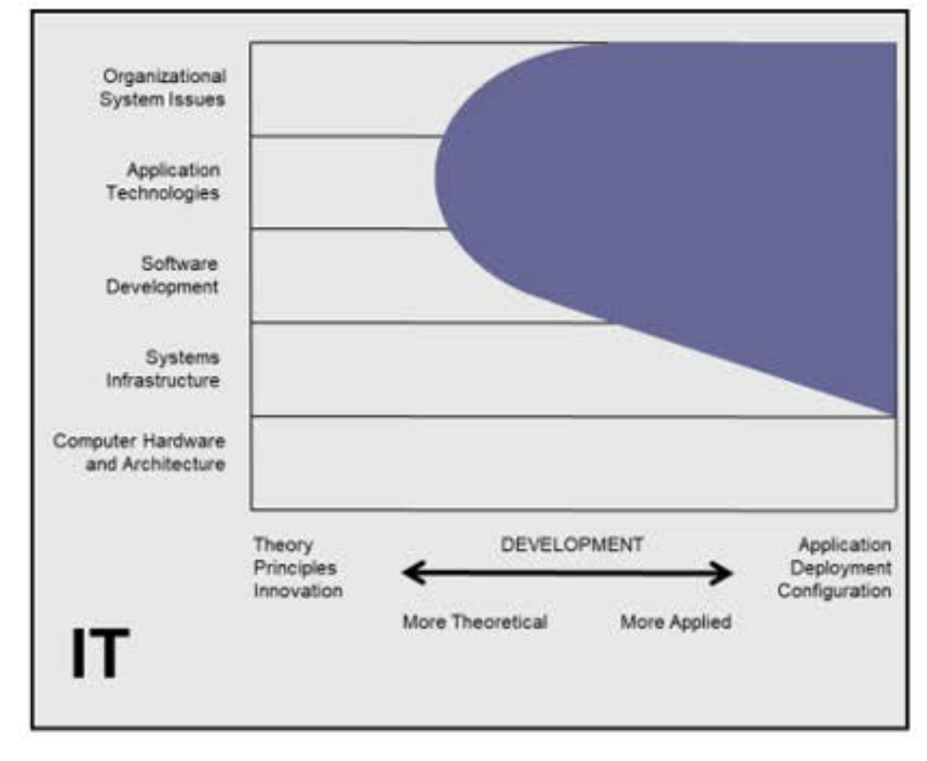
What is CS: discipline evolvement (CC2020)
Computing Science:
Computer engineering (from EE)
Computer science (into mature academic dicipline)
Cybersecurity
Information systems (computers into organization/working envir.)
Information technology (infrastructure)
Software engineering (emerging as a discipline based on CS/CE)
Data science
AI
Notes:
As originally expressed in CC2005 [Acm02], computing includes a variety of interpretations such as designing and constructing hardware and software systems for a wide range of purposes: processing, structuring, and managing various kinds of information; problem solving by finding solutions to problems or by proving a solution does not exist; making computer systems behave intelligently; creating and using communications and entertainment media; and finding and gathering information relevant to any particular purpose.

Slide 12
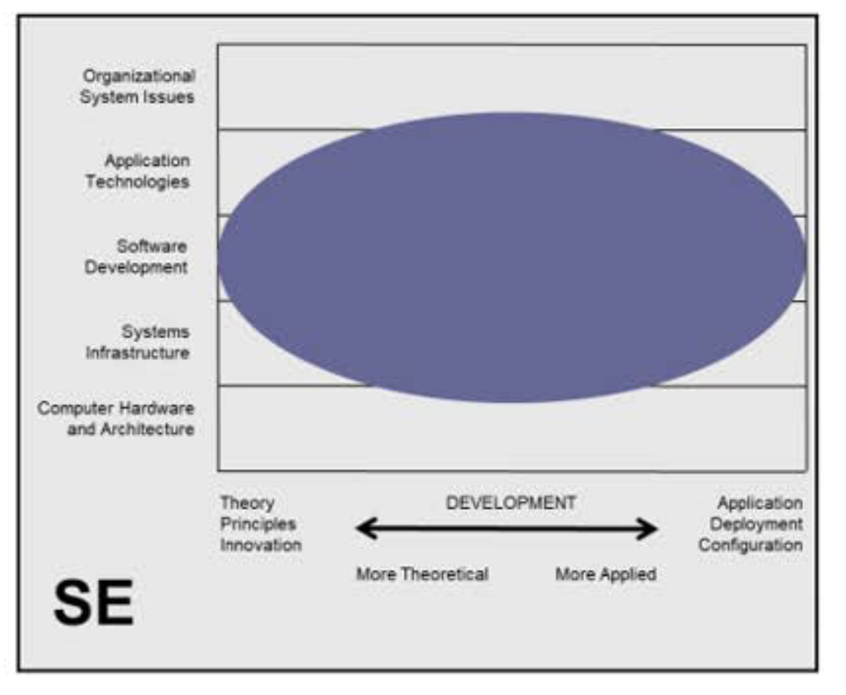
What is CS: discipline evolvement (CC2020)
Computing Science:
Computer engineering (from EE)
Computer science (into mature academic dicipline)
Cybersecurity
Information systems (computers into organization/working envir.)
Information technology (infrastructure)
Software engineering (emerging as a discipline based on CS/CE)
Data science
AI
Notes:
As originally expressed in CC2005 [Acm02], computing includes a variety of interpretations such as designing and constructing hardware and software systems for a wide range of purposes: processing, structuring, and managing various kinds of information; problem solving by finding solutions to problems or by proving a solution does not exist; making computer systems behave intelligently; creating and using communications and entertainment media; and finding and gathering information relevant to any particular purpose.

Slide 13
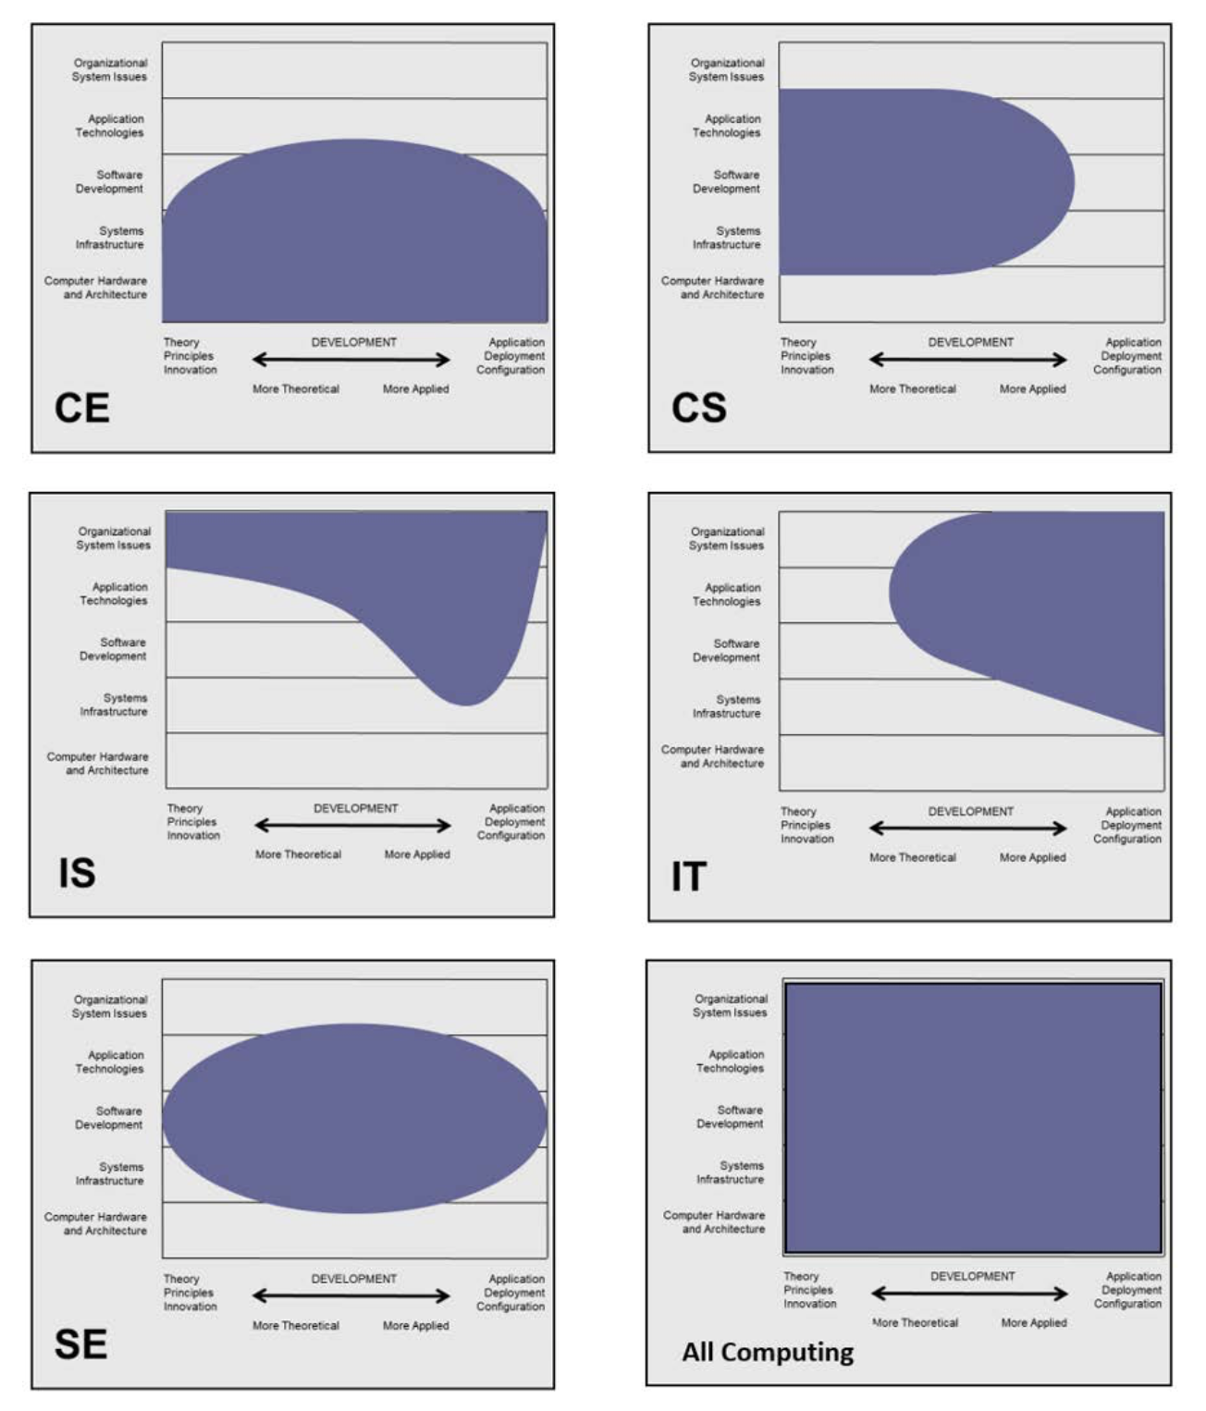
What is CS: discipline evolvement (CC2020)
Computing Science:
Computer engineering (from EE)
Computer science (into mature academic dicipline)
Cybersecurity
Information systems (computers into organization/working envir.)
Information technology (infrastructure)
Software engineering (emerging as a discipline based on CS/CE)
Data science
AI
Notes:
As originally expressed in CC2005 [Acm02], computing includes a variety of interpretations such as designing and constructing hardware and software systems for a wide range of purposes: processing, structuring, and managing various kinds of information; problem solving by finding solutions to problems or by proving a solution does not exist; making computer systems behave intelligently; creating and using communications and entertainment media; and finding and gathering information relevant to any particular purpose.

Slide 14
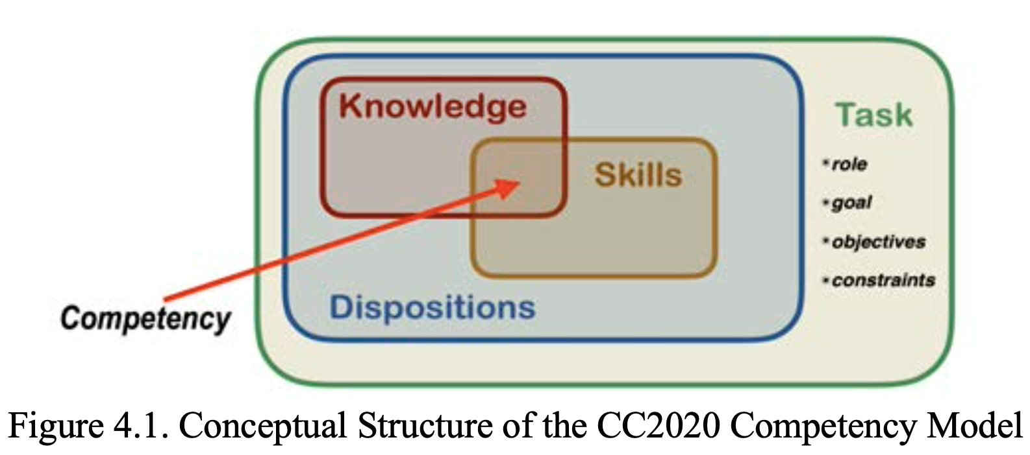
How to learn CS
Notes:
Competency 能力，胜任力

Slide 15
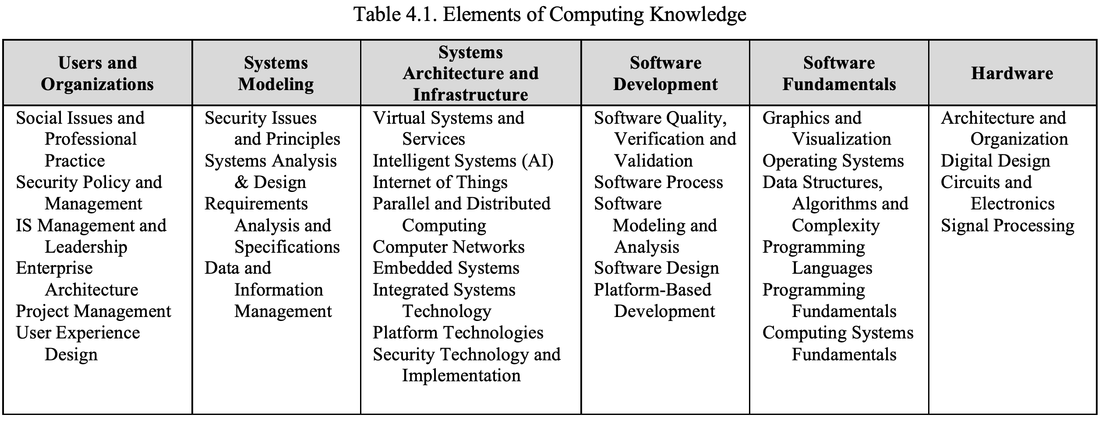
What is CS: CS knowledge (know-what)

Slide 16
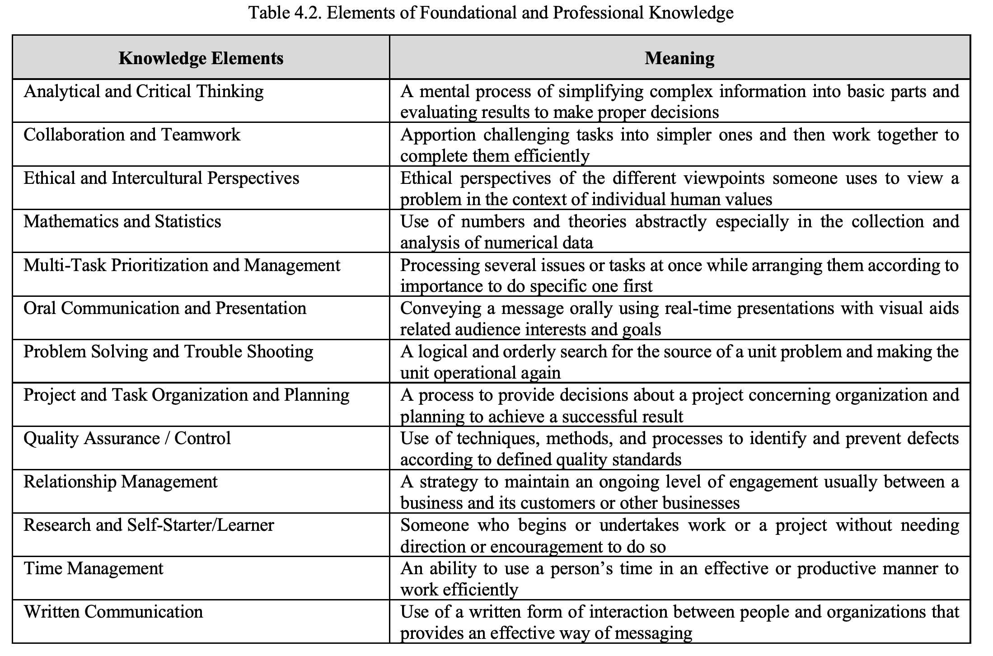

Slide 17
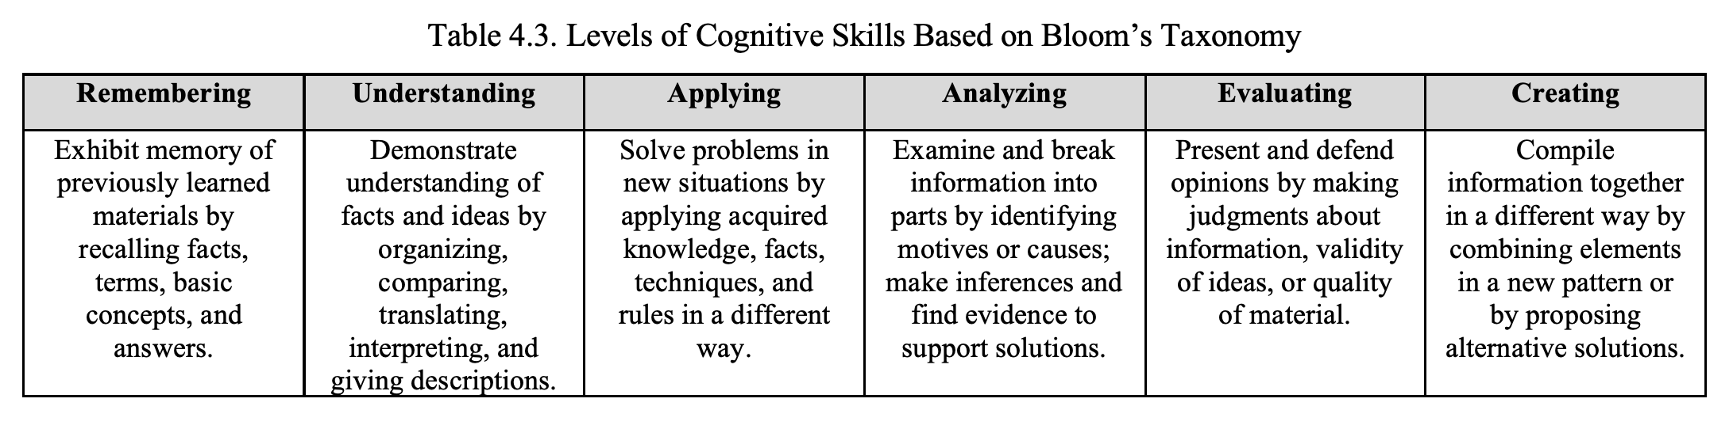
Skills: the proficient applying of knowledge (know-how)

Slide 18
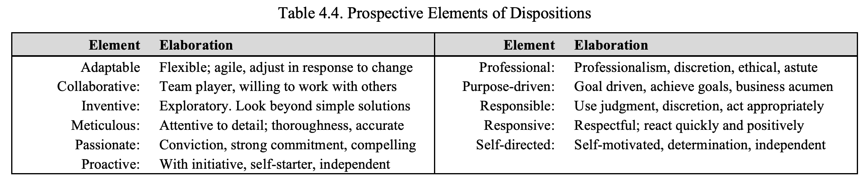
Dispositions: (know-why)
Notes:
Inventive :有创造力、别出心裁 meticulous:细节 proactive：积极主动先发制人 responsive:快速应答

Slide 19
Tips for learning CS
Doing by your own hands, instead of just thinking or talking
Programming for others, instead of just using others programs
Trying to solve real world problems, instead of just purely exercising clarified codings
(General) programming, tensor/vector programming, parallel programming, distributed programming
Entering lab as early as possible

Slide 20
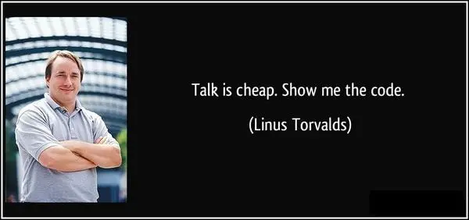

Slide 21


Slide 22

Q & A

